Slide 1
Advanced C++ Internals: Chapter 5: C++ Basics
ZACOCPPINT

Slide 2
Learning Journey:
C++ Basics
<iostream>
Recap: Classic C++
Recap: Modern C++
Auto
C++ Execution Flow
Logical
RE tool view
Class Review
SRE Class View in Ghidra Symbol table
vtable
Methods
static int variable
Name mangling
typeinfo
Finally: Access Control Enforcement
Lab #5
Classic vs. Modern C++
Summary
Appendices:
Useful links
Learning Outcomes:
Must be able to read Classic C++ program code
Should be able to read elements of Modern C++ program code
Could be able to read and write Modern C++ program code
C++ Basics

Slide 3

#include <iostream>
#include "T01.2_MakeCoffee.h"
int main()
{
std::cout << "Hello Basics!\n";
make_coffee();
auto myDrink = make_drink("Coffee");
std::cout << "Drinking " << myDrink.name() << std::endl;
while (myDrink.take_sip(10)) {
std::cout << " sip..";
}
std::cout << "\nFinished" << std::endl;
}
C++ Basics
Notes:
A slightly more interesting "Hello world!“
Apart from 'auto' there shouldn't be anything new here.
Prefer ‘iostream’ over unsafe C string library
Any Q's about what is here?
Most slide examples are in the labs for each chapter.
See the "Code_Takeaways" for worked examples.

Slide 4
<iostream>
cout
<<
any char*, numeric primitive or std::string
endl
<iomanip> for formatting
std::format – more on this later
Notes:
Ask if there is anything here you don't understand.
See https://en.cppreference.com/w/cpp/io/manip for formatting iostream
std::format (the modern way) - comes later.

Slide 5
Recap: Classic C++
C++ until 2011
C with classes
Obsessed with knowing type
Heavy reliance upon pointers
Direct memory management with "new" and "delete"
Tricky passing large objects around.
Notes:
Most of these aspects will not create robust executables without a great deal of care and attention on the part of the software engineer.
Some thoughts about this for you to consider:
C++ supports both procedural and OO paradigms; software engineer will have to juggle these – can be difficult for C programmer adapting.
C++ is strongly typed, requiring explicit type information which is both a blessing and a curse; provides strong compile-time checks but (often) increases the verbosity of the language.
Heavily reliance on pointers can be dangerous, leading to their mismanagement and resulting memory leaks, dangling pointers and segmentation faults; debug also becomes time-consuming.
Misuse of new and delete can lead to memory leaks and crashes as the burden is on the C++ software engineer. Smart pointers will help to manage memory more safely, but at this point – they’re not here.
Passing large objects by value in C++ can lead to performance issues; engineers have to be mindful of using references and pointers to avoid unnecessary copies; managing object lifetimes and ensuring proper ownership will help – but, you’ve guessed it… not here yet.

Slide 6
Recap: Modern C++
C++ since 2011
A new approach to programming
ISO C++ Core Guidelines
Strong focus on memory management, resource management, interfaces, and concurrency
Not just new features!
Focused on expressiveness
Preference for hiding type
Explicit lifetime management - rare use of "new" and "delete"
Zero-cost passing of large objects
Notes:
Modern C++ is not just a bunch of new features, but a paradigm shift in C++ programming.
Perhaps comparable to the shift from procedural programming to OOP.
Further reading:
https://github.com/isocpp/CppCoreGuidelines

Slide 7
auto x = 10;
auto myLambda = [](int x) { return x + 1; };
auto myDrink = make_drink("Coffee");
const auto& drinkView = myDrink;
auto
auto keyword deduces a copy-type
Infers type based on its initializer
Add reference and / or const if we wish
Programmer-Types
IHA - I Hate Auto (Classic programmers)
AAA - Almost Always Auto (Many modern C++ programmers)
AA - Always Auto (ISO Standard Committee's aim)
11
Notes:
auto is the bedrock of modern C++, both as a feature and as a concept.
The concept - applies to all modern C++
Hide type info
Let the compiler do the work
Zero-cost abstraction
Encourages better practices (no uninitialized variables)
Easier to read (left-to-right)
Arguably there’s also a reduction in code verbosity, especially for more complex types, lambda expressions, or use of templating and generic programming. e.g.
std::vector<int>::iterator my_iter = vec.begin();
becomes:
auto my_iter = vec.begin();

Slide 8
In Software Engineering we’re used to saying C++’s main() is the entry point to our program, but it’s really some distance in…
OS loader loads the program's executable and dependencies (e.g., shared libraries) into memory.
Stack and Heap are setup
Control passed to _start function; part of the C runtime library (crt0 or similar)
_start preps argc and argv (OS has placed on stack) for main() to use
_start initialises any necessary parts of the run-time library, e.g. global constants etc.
__lib_start_main sets up exception handling, I/O and registers the atexit handler, calls our main() with its args
main() runs with args and on completion typically returns SUCCESS status code 0 back to __lib_start_main
__lib_start_main calls _exit with returned STATUS code, destructors called on statics and globals; control passed back to OS
_start calls __lib_start_main, part of the GNU C Library (glibc)
C++ Execution Flow (logical)
Notes:
At least on something Unix-like, it will vary depending on platform, tooling etc.
You will find references to these specific “under the hood” function names (used before and after main()’s execution) in the .text section of your binary; this means you should be able to follow the flow and navigate the C++ execution flow in your SRE tool (e.g. Ghidra, IDAPro etc.)

Slide 9
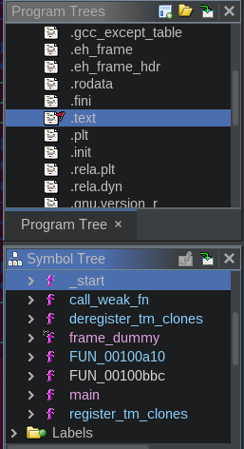
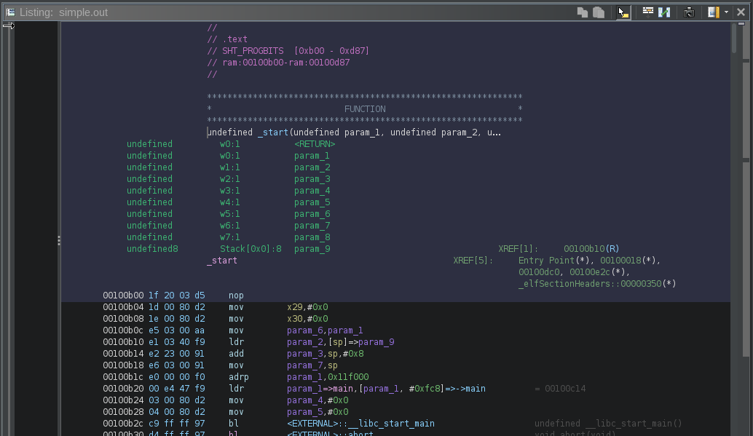
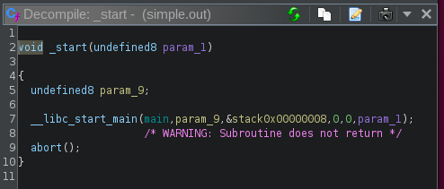
C++ Execution Flow (RE tool)
Notes:
Ghidra’s Views connected: Program Tree, Symbol Tree, Listing and Decompilation (after initial analysis has been completed)
You can see the _start function mentioned on previous slide, its call to __libc_start_main and our main() function as its first argument.

Slide 10
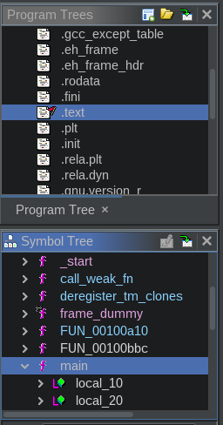
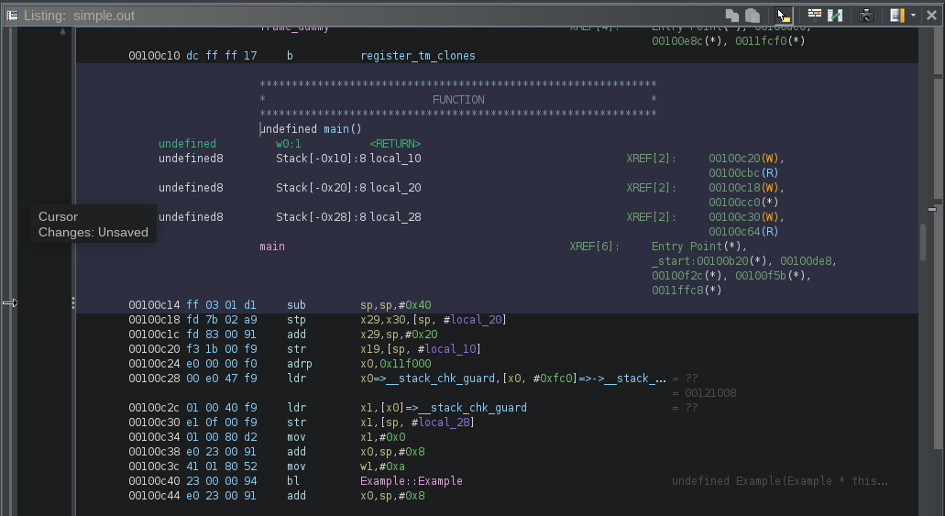
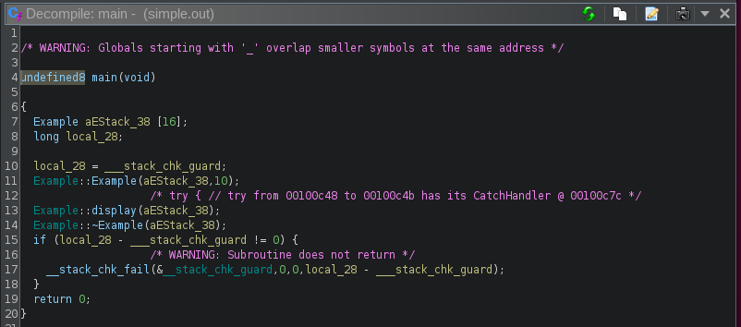
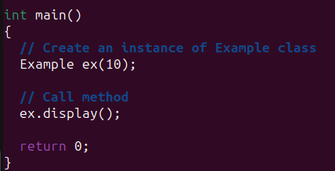
C++ Execution Flow (RE tool)
Notes:
Here we are following __lib_start_main to our main() function…
Note.
Also shown for comparison is the original source code for main(), providing a comparison to its (default) decompiled equivalent in Ghidra.

Slide 11
class Example {
public:
Example(int v) : value(v) {}
virtual ~Example() {}
void display() const { std::cout << value << std::endl; }
static int getCount() { return count; }
private:
int value;
static int count;
};
int Example::count = 0;
Class Review
Object of Example
vptr
value (int)
Points to the vtable for Example
(if virtual functions exist)
Global Memory
Example::count (int)
Example::vtable
Static member
~Example()
Notes:
For data members (properties)
Essentially, non-static data members are stored within the instance of the class (the object).
Layout of these member-types are sequential according to their declaration
Usually adjusted for alignment requirements
Static data members are not stored in the instance of the class.
There is one instance in memory, shared by all instances
Typically, in a globally accessible memory area, akin to global variables
For function members (methods)
Non-static member functions do not occupy space in instances of the class
Just one set of code, shared by all instances
Properties used in member functions are differentiated through the use of the “this” pointer, which points to the specific instance in use (providing our OOP run-time polymorphism)
Static member functions are also not part of the individual class instances
Exist as standalone functions with class scope
Virtual function members (methods)
Any class with a virtual function has a virtual table (vtable)…
Or those classes which inherit from a class with virtual functions
This is used to support dynamic dispatch (i.e. picking the correct version of the overridden method for the object being references)
Each class instance (object) contains a point (vptr) to the vtable of its class
The vtable contains pointers to the class’s virtual functions

Slide 12
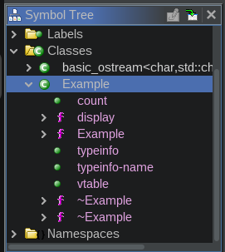
SRE tools like Ghidra will use a variety of techniques when analysing a binary executable to identify the existence of a C++ class (or classes):
Disassembly and identification of sections, symbols and functions
Pattern recognition for functions’ prologues and epilogues
Identification of vtables for class inference
Use of RTTI (Runtime Type Identification)
Heuristics for typical class layout
One of the most useful “at a glance” tools generated is the symbol tree – a hierarchical representation of an interpreted symbol table.
SRE Class View In Ghidra: Symbol Table

Slide 13
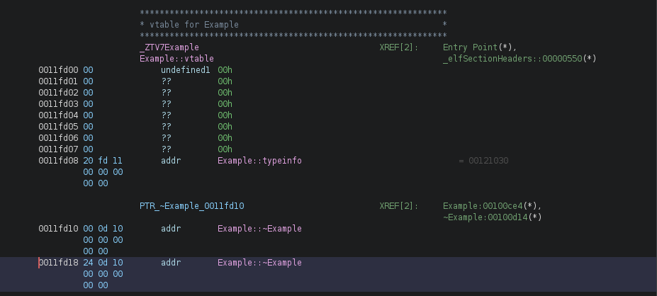
Here’s the vtable for the Example class:
Note pointers to two different addresses, each (probably) with a different implementation of the class destructor (Example::~Example)
We’d expect that as the destructor was tagged with C++’s “virtual” keyword.
SRE Class View in Ghidra: vtable
Notes:
In the provided C++ class Example, we have defined a virtual destructor.
The inclusion of a virtual destructor (or indeed any virtual function) means that the class will have a virtual table (vtable) associated with it.
Note that two destructors are generated when a destructor is polymorphic. This is to support specialized operator delete on derived classes. Operator delete is a static class function, not getting a this-pointer, so it cannot support normal polymorphic mechanisms. So instead, two destructors are generated, mangled as D0 and D1.
D0 is called the "deleting destructor". This is called when delete is called on the object. It delegates to any specialized operator-delete, and the global operator-delete is not called.
D1 is the member destructor, and is called whenever an object of this class goes out of scope. (It might be on the stack or be a sub-member of another class).
Virtual inheritance generates yet another destructor, D2. This is the member destructor for virtual base-classes
Also take note of the typeinfo entry flagged – more on this later!

Slide 14
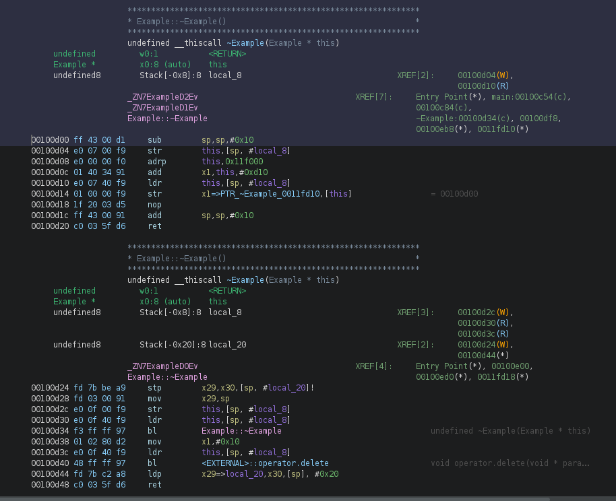
Here are the methods encapsulated in the class.
SRE Class View in Ghidra: methods (1)
~Example
(destructor) @ 00100d00
~Example
(destructor) @ 00100d24
Note code is not identical
Notes:
The addresses for the destructors match the entries in the vtable.

Slide 15
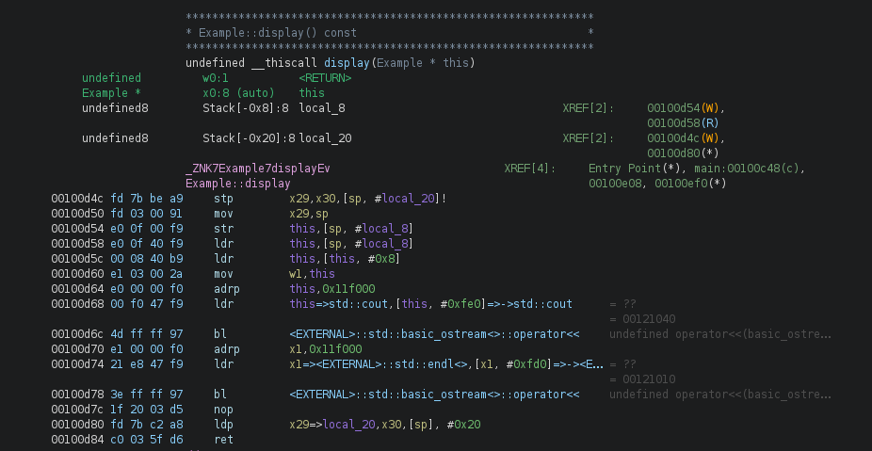
Here are the methods encapsulated in the class.
SRE Class View in Ghidra: methods (2)
Single display method
@ 00100d4c
Notes:
The addresses for the destructors match the entries in the vtable.

Slide 16


Here’s the static int variable declared within the class:
Note that for mangled names, each symbol and letter represents a facet of encoded information.
Q. Do you know what _Z, N, 7, 5 and E represent here?
SRE Class View in Ghidra: static int variable
Notes:
Breakdown of "_ZN7Example5CountE“ mangled name…
_Z: This prefix starts almost all mangled names in GCC and indicates that what follows is a mangled name according to the C++ ABI (see further reading).
N...E: This indicates the start (N) and end (E) of a nested name (or a sequence of names, which could include a class name followed by a method or a nested class, etc.). The names between N and E are further broken down into length-prefixed components.
7Example: This part decodes as follows:
7 indicates that the next 7 characters are part of the name.
Example is the name itself, referring to a class or namespace named "Example".
5Count: Similarly, this part is decoded as:
5 indicates that the next 5 characters are part of the name.
Count would typically represent either a function or a static member variable within the class "Example".
E: This marks the end of the nested name sequence.
Further reading:
(No date) Itanium C++ ABI. Available at: https://itanium-cxx-abi.github.io/cxx-abi/abi.html (Accessed: 2 May 2024).

Slide 17
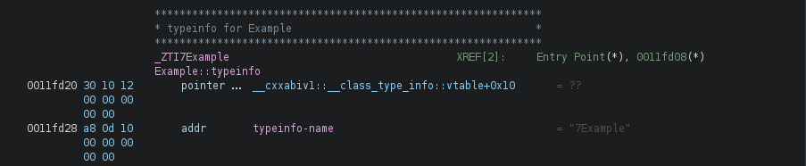
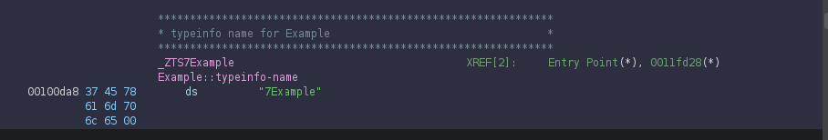
Here are the typeinfo entries for the Example class:
Similarly, _ZTI7Example and _ZTS7Example should be decodable…
SRE Class View in Ghidra: typeinfo
Notes:
The typeinfo structure is primarily used to hold the runtime type information of an object.
In C++, this is accessed via the typeid operator, which returns a reference to a std::type_info object containing information about the type.
To use RTTI features, including typeid, the header file <typeinfo> must be included.
vtable and RTTI
RTTI data structures often include pointers to type information (typeinfo objects), which are stored along with the virtual method table (vtable) in memory. This happy arrangement permits dynamic type checks and safe type casts using dynamic_cast.
Locating typeinfo structures in a binary can be done by identifying specific patterns or known offsets relative to vtables. This can help in mapping out class hierarchies and object relationships.
Technical notes.
It’s worth remembering that the names returned by typeinfo (e.g., from type_info::name()) are usually mangled in binaries compiled with C++.
It’s important to understand the name mangling scheme used by the compiler to successfully “demangle” these names to their original, human-readable form.

Slide 18

As you’re no doubt aware, C++ access control of class members uses three accessor specifiers:
Public – accessible from outside the class
Protected – accessible only within the class and by derived class instances
Private – accessible only within the class itself
It’s important to remember that this is enforced at compile time not run-time.
Finally: Access Control Enforcement
Notes:
What this essentially means…
The compiler checks access-levels during compilation process and will abort and emit an error if a type of forbidden class member access is attempted, e.g. accessing a private member from outside the object
No run-time checks means no execution overhead for further visibility checking. ☺
So, in other words, from an SRE perspective, you’re not going to find any such checks in the executable.
It may also be worth noting – we’re sure your familiar with accessors and mutators?
Well, const member functions (const accessors) and “const-correctness” have been foundational aspects in good C++ design since its earliest specification, e.g.
class MyClass {
private:
int data;
public:
MyClass(int val) : data(val) {}
// Const accessor: promises not to modify the object
int getData() const {
return data;
}
};
And…
void printData(const MyClass& obj) {
std::cout << obj.getData() << std::endl; // Can only call const member functions, such as the one above…
}

Slide 19
C++ Internals Lab #5
Modern C++
Notes:
This lab focuses on modern C++ code.

Slide 20
C++ code represents two major “eras”:
Classic
Modern (from C++ 11 onwards)
Classic C++ code mostly seen as “C with classes”
Will not (generally) create robust executables
Core Classic C++ concepts include:
Use of streams for input and output
Use of new and delete keywords for dynamic data
Use of pointer manipulation
Modern C++ concepts focus on:
Memory management,
Resource management
Interfaces
Concurrency
Not all C++ concepts (classic or modern) will translate to machine code e.g. access control enforcement - but evidence of virtual methods can be readily identified.
Summary

Slide 21
Any questions?

Slide 22
Appendices
Notes:
Some additional information you may find useful…

Slide 23
Websites and online resources
GCC, the GNU Compiler Collection (no date) GCC, the GNU Compiler Collection - GNU Project. Available at: https://gcc.gnu.org/ (Accessed: 16 November 2023).
Tool Interface Standard (TIS) Executable and Linking Format (ELF) Specification Version 1.2 (no date). Available at: https://refspecs.linuxfoundation.org/elf/elf.pdf (Accessed: 16 November 2023).
C++ Standard Library (no date) cppreference.com. Available at: https://en.cppreference.com/w/cpp/standard_library (Accessed: 16 November 2023).
JTC1/SC22/WG21 - The C++ Standards Committee - ISOCPP (no date) . Available at: https://www.open-std.org/jtc1/sc22/wg21/ (Accessed: 16 November 2023).
Isocpp (no date) isocpp/CppCoreGuidelines: The C++ Core Guidelines are a set of tried-and-true guidelines, rules, and best practices about coding in C++, GitHub. Available at: https://github.com/isocpp/CppCoreGuidelines (Accessed: 1 January 2024).
(No date) Itanium C++ ABI. Available at: https://itanium-cxx-abi.github.io/cxx-abi/abi.html (Accessed: 2 May 2024).
Useful resources

Slide 24
Review of Chapter’s Learning Outcomes

Slide 25
Learning Outcomes:
By the completion of this chapter, you…
Must be able to read Classic C++ program code
Should be able to read elements of Modern C++ program code
Could be able to read and write Modern C++ program code
Please review these learning outcomes at chapter's end.
Learning Outcomes

